Slide 1


Data extraction through Online Platforms
American Community Survey
(ACS)
IPUMS
data.census.gov

Slide 2

Who’s teaching today?
Samantha De Leon, MD
Panamanian/Argentinian ☺
In Cornell University for 3 years now
Pursuing a PhD in Human Development and Psychological Sciences
I research Social Neuroscience and Health in the Life History Lab
sd567@cornell.edu

Slide 3
Agenda
Take snacks and swag!
Our slides and materials are on the github page!
The American Community Survey (ACS)
Online Platforms
Data.Census.Gov
IPUMS
Extracting Data
Data.Census.Gov
IPUMS
Pros and Cons: Data.Census.Gov vs IPUMS
Exercise

Slide 4
The American Community Survey ACS
American Community Survey

Slide 5
American Community Survey (ACS)
American Community Survey
What is it?
How often is done?
How often is it released?
Where is it collected?
Who collects and summarizes it?
Ongoing continuous survey
Yearly, but daily collection, since 2001.
They yearly release last year’s pooled data.
Nationwide. Participation is mandatory.
The Census Bureau
U.S. Census Bureau. (2017). American Community Survey Information Guide. Retrieved from [https://www.census.gov/content/dam/Census/programs-surveys/acs/about/ACS_Information_Guide.pdf]
Notes:
Each address has about a 1-in-480 chance of being selected in a month, and no address should be selected more than once every 5 years.
The Census Bureau mails questionnaires to approximately 295,000 addresses a month across the United States.
his is a small number of households considering there are more than 140 million eligible addresses in the United States,
The ACS has an annual sample size of about 3.5 million addresses, with survey information collected nearly every day of the year. Data are pooled across a calen- dar year to produce estimates for that year. As a result, ACS estimates reflect data that have been collected over a period of time rather than for a single point in time as in the decennial census, which is conducted every 10 years and provides population counts as of April 1 of the census year.
Starting with the 2014 ACS, the Census Bureau is also produc- ing “1-year Supplemental Estimates”—simplified ver- sions of popular ACS tables—for geographic areas with at least 20,000 people.

Slide 6
American Community Survey (ACS)
American Community Survey
What does it collect?
How do they collect it?
How big is their sample?
Who uses this data?
Why do they collect it?
Social, economic, housing, and demographic information.
Both online and on paper, invitation to 1/38 households
Annual 3.5 million households selected by address of areas with at least 65 000 people.
Public officials, planners, entrepreneurs
Inform the federal budget yearly
U.S. Census Bureau. (2017). American Community Survey Information Guide. Retrieved from [https://www.census.gov/content/dam/Census/programs-surveys/acs/about/ACS_Information_Guide.pdf]
Notes:
Each address has about a 1-in-480 chance of being selected in a month, and no address should be selected more than once every 5 years.
The Census Bureau mails questionnaires to approximately 295,000 addresses a month across the United States.
his is a small number of households considering there are more than 140 million eligible addresses in the United States,
The ACS has an annual sample size of about 3.5 million addresses, with survey information collected nearly every day of the year. Data are pooled across a calen- dar year to produce estimates for that year. As a result, ACS estimates reflect data that have been collected over a period of time rather than for a single point in time as in the decennial census, which is conducted every 10 years and provides population counts as of April 1 of the census year.
Starting with the 2014 ACS, the Census Bureau is also produc- ing “1-year Supplemental Estimates”—simplified ver- sions of popular ACS tables—for geographic areas with at least 20,000 people.

Slide 7
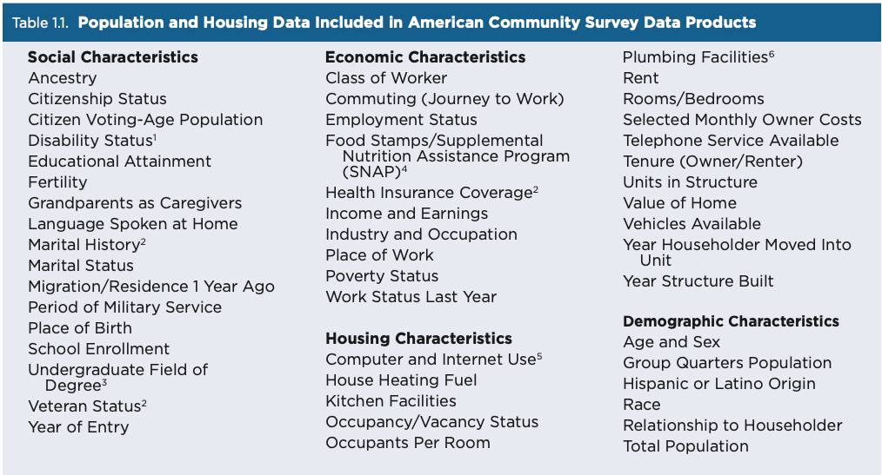
What is the American Community Survey (ACS)?
What does it collect?
U.S. Census Bureau. (2020). Understanding and using American Community Survey data: What all data users need to know. U.S. Census Bureau. [https://www.census.gov/content/dam/Census/library/publications/2020/acs/acs_general_handbook_2020.pdf]

Slide 8
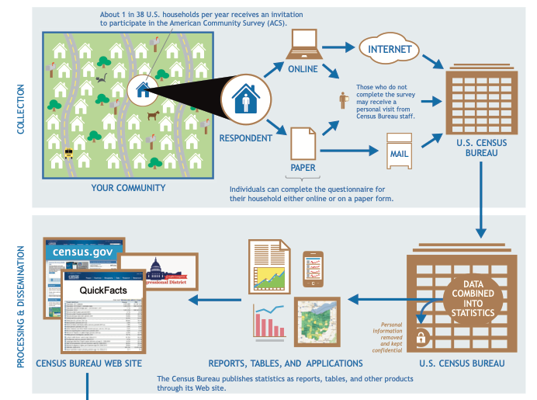
American Community Survey
U.S. Census Bureau. (2017). American Community Survey Information Guide. Retrieved from [https://www.census.gov/content/dam/Census/programs-surveys/acs/about/ACS_Information_Guide.pdf]

Slide 9
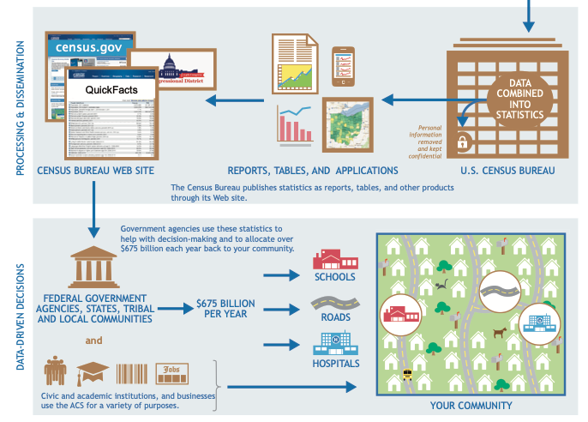
American Community Survey
U.S. Census Bureau. (2017). American Community Survey Information Guide. Retrieved from [https://www.census.gov/content/dam/Census/programs-surveys/acs/about/ACS_Information_Guide.pdf]
Notes:
For example, questions about how people get to work, when they leave, and the length
of their commutes are used for planning improve- ments to roads, highways, rail lines, and bus routes, and for planning emergency response routes

Slide 10
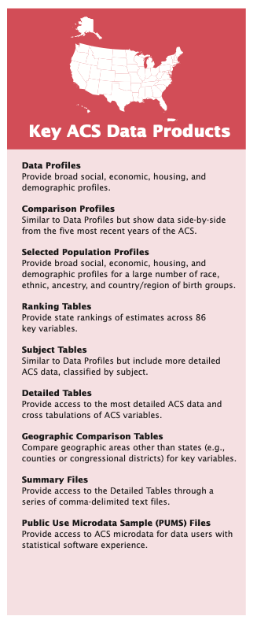
American Community Survey
U.S. Census Bureau. (2017). American Community Survey Information Guide. Retrieved from [https://www.census.gov/content/dam/Census/programs-surveys/acs/about/ACS_Information_Guide.pdf]

Slide 11
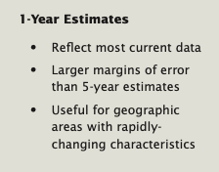
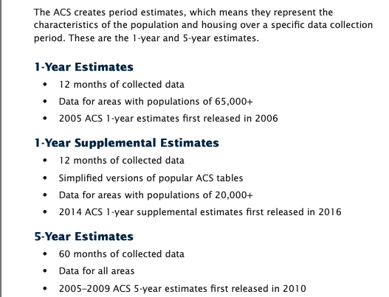
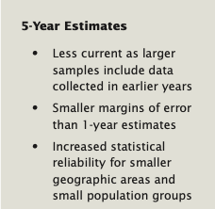
American Community Survey
U.S. Census Bureau. (2017). American Community Survey Information Guide. Retrieved from [https://www.census.gov/content/dam/Census/programs-surveys/acs/about/ACS_Information_Guide.pdf]

Slide 12
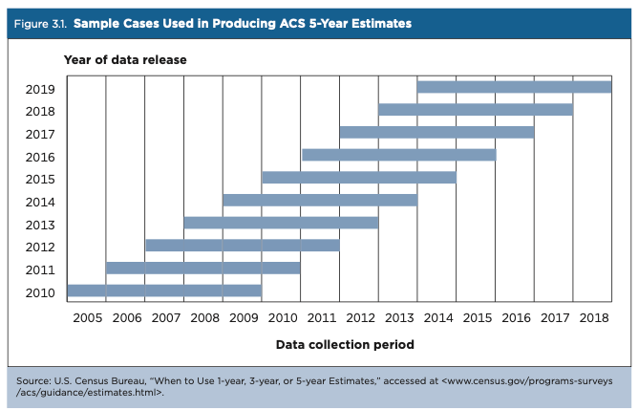
American Community Survey

Slide 13
Some recommendations
What is the American Community Survey (ACS)?
Don’t compare 1 year to 5-year estimates
Don’t compare 5-year estimates that overlap
Questions may change
If you see too much change one year to the next, consider sample variation may be the cause. Check with 5-year estimates.

Slide 14

Questions?

Slide 15
Online Platforms to Obtain ACS and Census Data
Online Platforms

Slide 16
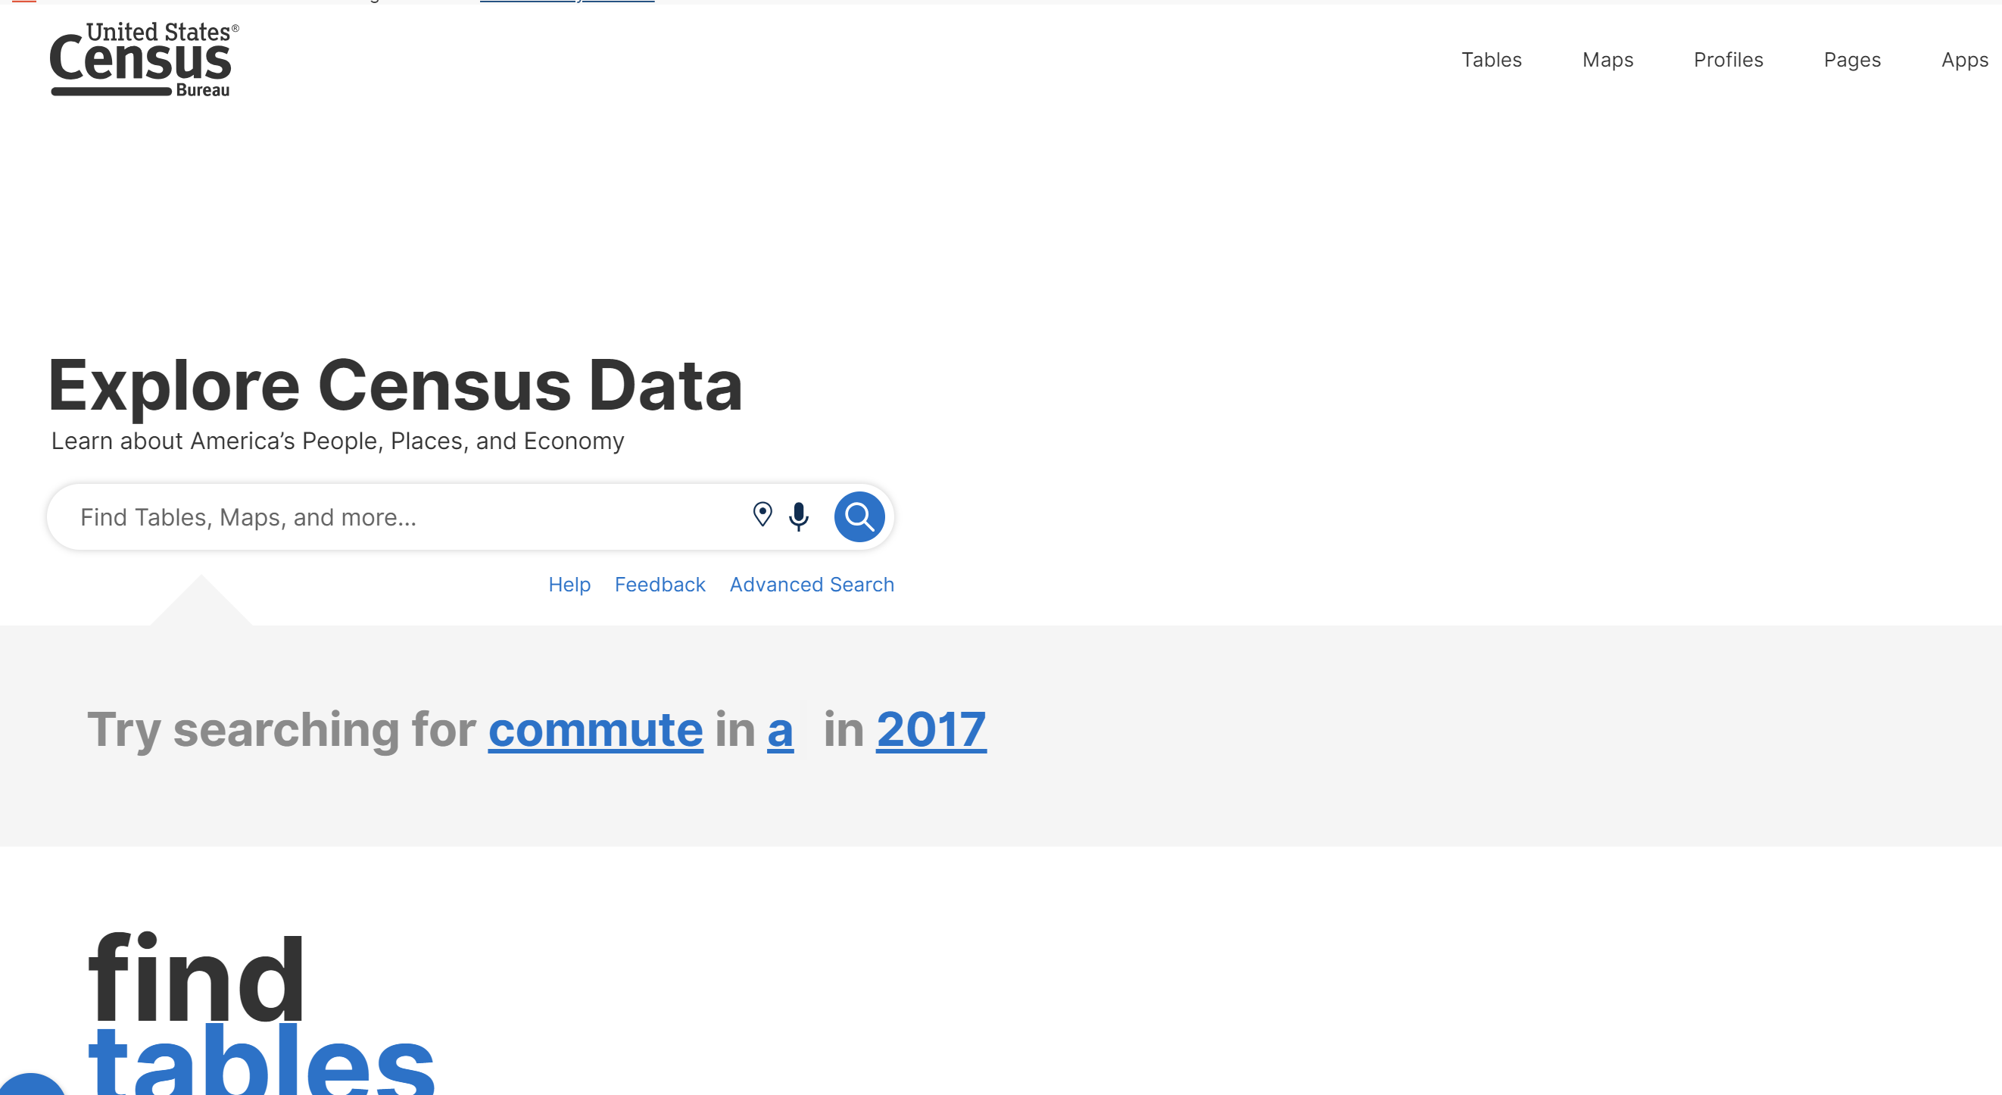
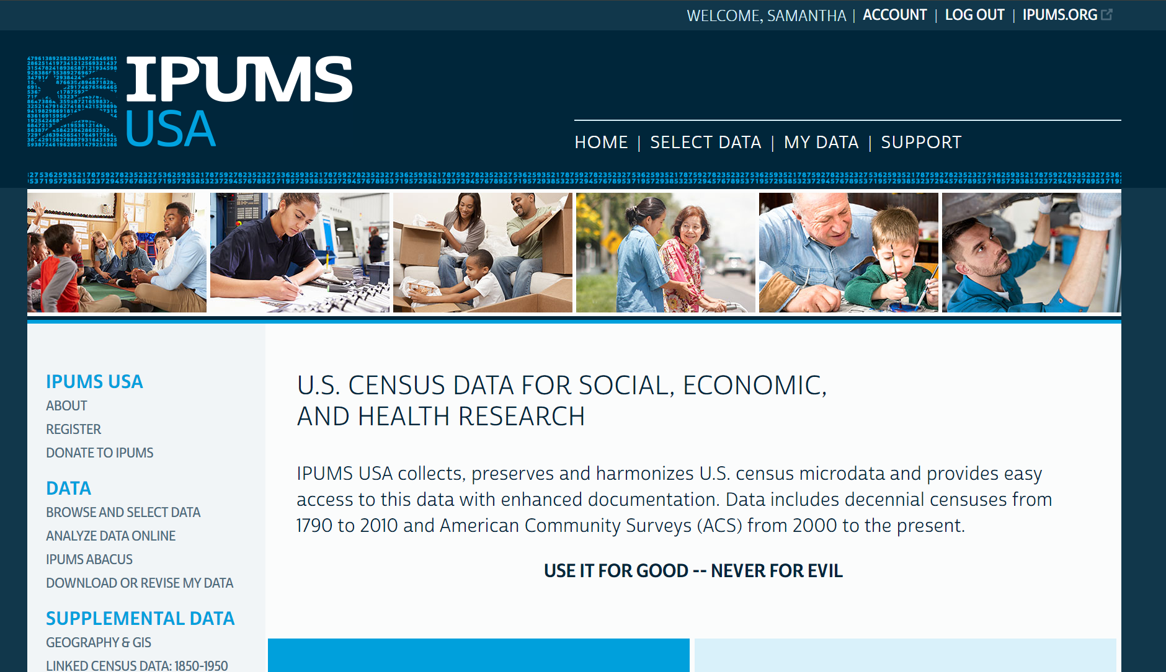
Online Platforms
Online Platforms
Data.census.gov
IPUMS
https://data.census.gov/
https://usa.ipums.org/usa/
Summary Data
Visualize and Extract
No Registration Needed
MicroData
Extract
Free Registration Required

Slide 17
Data.Census.Gov
Online Platforms
Data Profiles by subject for a single geographic area
Subject Tables by topic separated by age, sex, race
Supplemental Estimates (<20 000 populated areas)
Comparison Profiles: 5 years to 5 years
Explore Tables:
Use filters to select Geography, Survey Name, Variables, etc.

Slide 18
Other tools for extracting data from data.census.gov
Online Platforms
My Congressional District for popular topics
My Tribal Area: for American Indian and Alaska Native areas, 5-year estimates of population and housing subjects
Census Business Builder: by county/zip codes/neighborhoods, potential customers info like customer spending
QuickFacts: by state, county, city, town for most commonly requested topics
Ranking Tables by state for 80 key ACS variables
Narrative Profiles: short analytic reports from 5-year estimates covering 15 topics text and charts
OnTheMap for emergency Management: real time, areas affected by natural disasters

Slide 19
Other Advanced Tools from data.census.gov
Online Platforms
The Census Bureau’s Application Programming Interface (API)
Custom tables: for purchase min $3 000, 8 weeks
GIS shapefiles and Geodatabase files: legal and geographic boundary areas, roads, railroads, and rivers
Census flows mapper: county to county migration 5-year
Restricted-Use Microdata: for s universities, research institutions, approved projects

Slide 20
Data Extraction
Data.census.gov

Slide 21
Data.census.gov
Extracting Data
https://usa.ipums.org/usa/
Sample:
Topics: Health Insurance
Geography: All counties in New York
Years: 2017
Survey: data from the Economic Census

Slide 22
Questions?

Slide 23
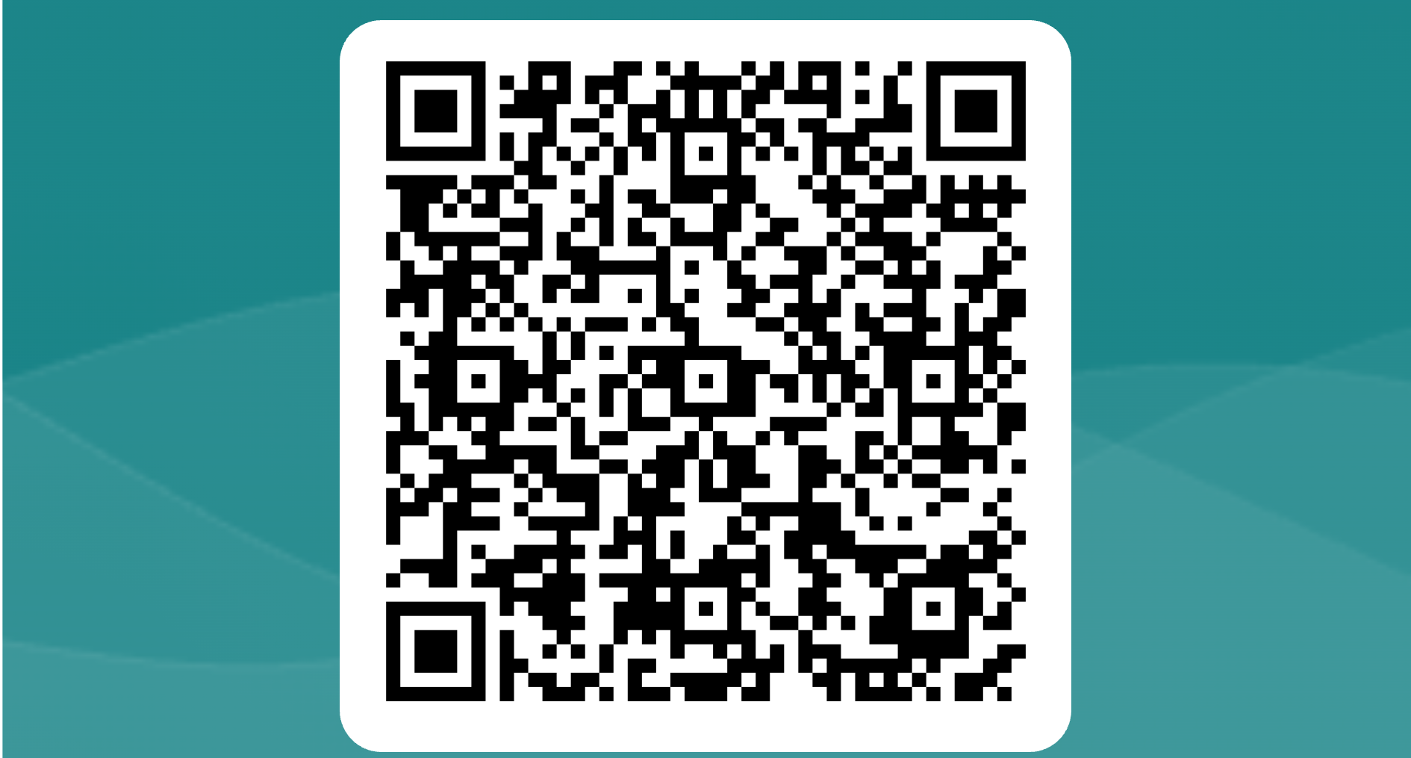

Slide 24
Online Platforms
Online Platforms
Data.census.gov
IPUMS
https://data.census.gov/
https://usa.ipums.org/usa/
Summary Data
Visualize and Extract
No Registration Needed
MicroData
Extract
Free Registration Required

Slide 25
IPUMS
Online Platforms
Integrated Public Use Microdata Series
Micro: individual, instead of aggregated tabular form
personal (record type: P)
households (record type: H)
Limits to prevent identification:
residence,
place of work,
very high incomes
IPUMS USA collects, preserves and harmonizes:
U.S. census data 1850-1880 (no Native Americans data), 1900-present,
American Community Surveys (ACS) from 2000 to the present
Puerto Rican Community Surveys of 2005-present
Richest source of quantitative information on long-term changes in the American population.
Easy access and Documentation
Notes:
hierarchical, where, like in the raw data files, person-level records follow the households to which they belong or rectangular, where household information is attached to each person record.

Slide 26
Online Platforms
IPUMS
Create your own tables
Free
Worldwide
Data available for individuals and are sequenced according to their household relationship codes
Household head appears first.
Variable: Relate
Relatives: codes 1-10
Non-relatives codes 11-13
Coding files to import data
Users will specify the formats (SPSS, STATA or SAS) of their command lines
Each sample is independent: cannot trace individuals from one census to the next.

Slide 27
IPUM variables
Online Platforms
All Numeric, except!
RECTYPE - Record Type
STREET - Street Address
NAMELAST - Name, last
NAMEFRST - Name, First
INDNAICS - Industry, NAICS
OCCSOC - Occupation, SOC
Each record contains a serial number
links the persons in the housing unit to the appropriate household record

Slide 28
SAMPLE WEIGHTS
Online Platforms
Not all samples are flat! (1:1 representation in sample:universe)
Some samples had little or extra access to certain populations, hence..
They require weighting!
This is included in your metadata ☺ and in the sample descriptions.

Slide 29
Data Extraction
IPUMS

Slide 30
IPUMS
Extracting Data
Sample:
Register
Pick a Variable
Pick a Sample
View Cart
What are all these extra variables?!
Create Data Extract
Choose Data Format
Choose Structure
Download Data
Decompress Data
Download Metadata (codebook)
Copy command text if needed

Slide 31
Questions?

Slide 32
IPUMS
Data.census.gov
Micro data
Code provided for importing data
Registration Needed
Data Extraction Only
Summary Aggregate data
User must clean data
No Registration needed
Visualize and Extract

Slide 33
Evaluation

Slide 34
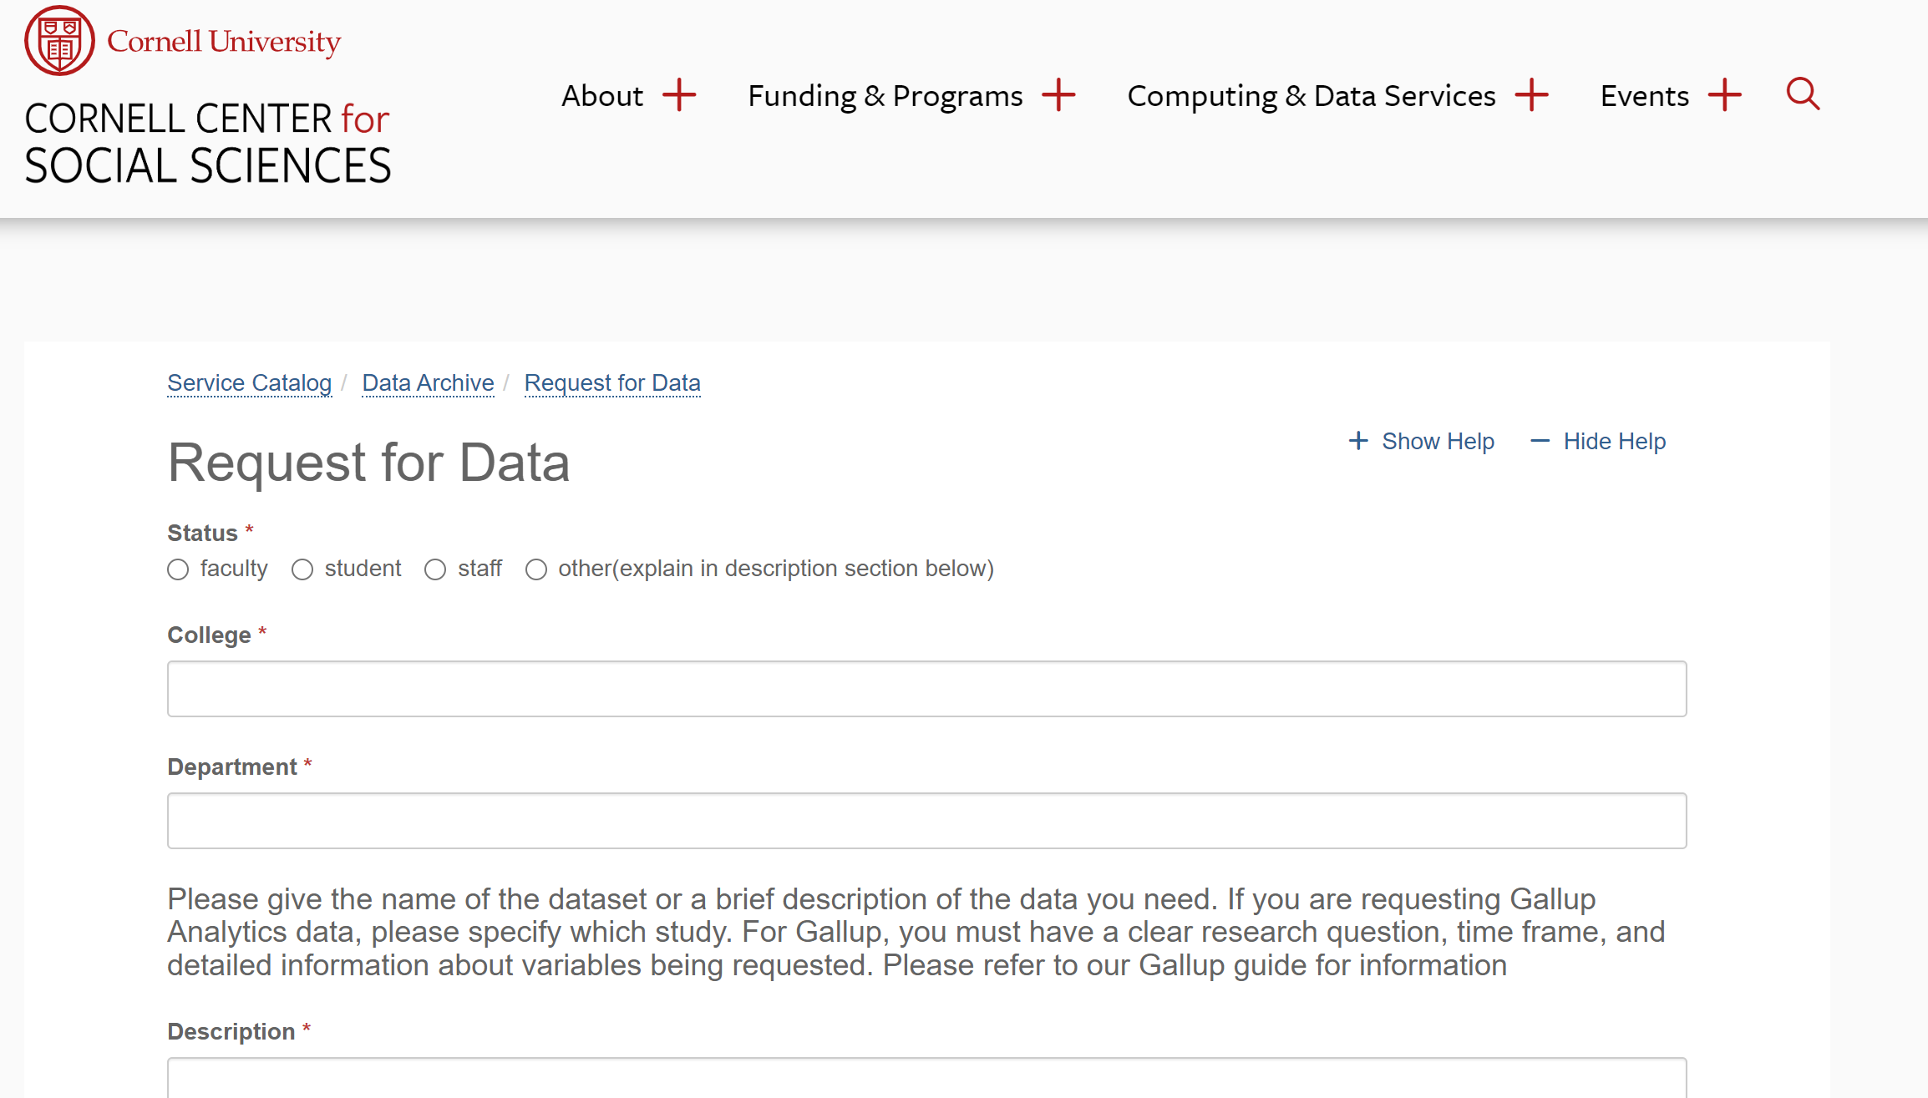
CCSS Other Resources
Request for data
https://socialsciences.cornell.edu/research-support/request-data

Slide 35
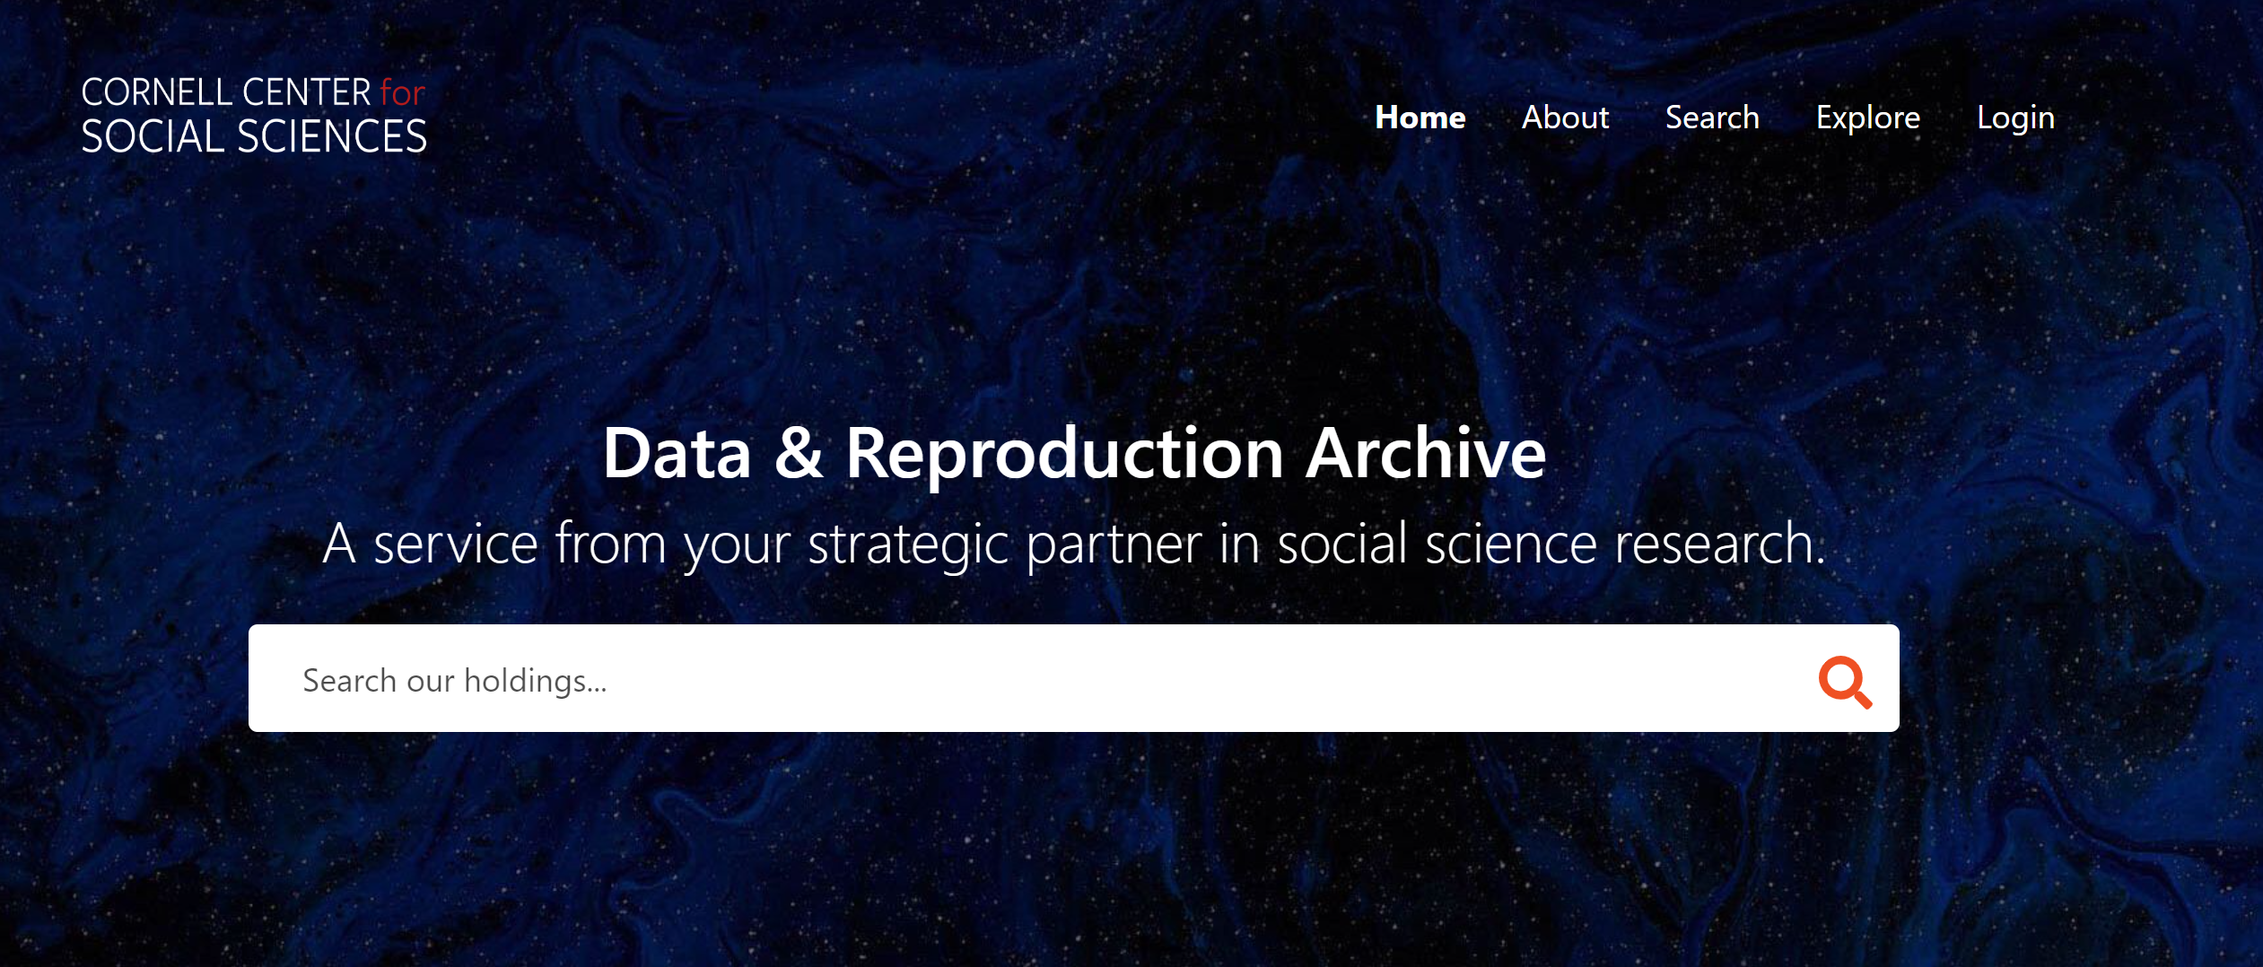
CCSS Other Resources
Data Archive
https://archive.ciser.cornell.edu/

Slide 36
Sources
https://www.census.gov/content/dam/Census/library/publications/2020/acs/acs_general_handbook_2020_ch09.pdf
https://usa.ipums.org/usa/
https://www.census.gov/data/what-is-data-census-gov/guidance-for-data-users/how-to-materials-for-using-data-census-gov.html

Slide 37
Exercise
Exercise
Extract from https://data.census.gov/table
Search for following characteristics:
ACS 5 year estimate detailed table. Educational Attainment, School enrollment for all the counties in the state of New York from 2010-2015
Tutorials:
https://www.census.gov/data/what-is-data-census-gov/guidance-for-data-users/how-to-materials-for-using-data-census-gov.html

